Slide 1
Lesson objective
Need calculators and whiteboards.
Title: Probability applications
Aim:
Use probability to inform choices
Plan:
Review
Two-way tables and Venn diagrams
Using probability (Game?)

Slide 2
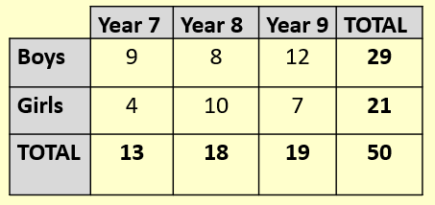
Whiteboards
Girls and boys from a school were surveyed.
How many in total?
Selecting students at random
b) P(year 9)
c) P(Year 8 and girl)
d) P(year 9 or 8)

Slide 3
Review: whiteboards
100 people were surveyed about their pets.
45 owned cats
65 owned dogs
25 people owned both
P(owned a cat)
P(dog OR cat)
P(dog AND cat)
P(didn’t own a cat)
U = 100
Cats
Dogs
20
25
40
15

Slide 4
Individual practice
Page 374 – Questions 2 – 4
Page 381 – Questions 1 and 2

Slide 5
Crayfish game

